Slide 1
Bell Work From last time… Page 878 #8, 43, 59, 71

Slide 2
Pre-calc trig
Day 21

Slide 3
Things to Study for Test
Degree, Max, Min, Zeros, End Behavior, Domain and Range.
Write equation given zeros (real and imaginary)
Simplify with imaginary
Factor and find all zeros with graph
Sketch a graph and write equation given characteristics of a rational function
Identify vertical, horizontal asymptotes, holes, x-intercepts and y-intercepts

Slide 4

Equations “Needed” for Test
$$\sqrt{−1}=i$$
$${y−y}_{1}=m\left(x−x_{1}\right)$$
$$x=\frac{−b±\sqrt{b^{2}−4ac}}{2a}$$
$${\text{Given} \text{f}\text{(}\text{x}\text{) }\text{then} f}^{′}\left(x\right)=\lim_{h→0}{\frac{f\left(x+h\right)−f(x)}{h}}$$

Slide 5
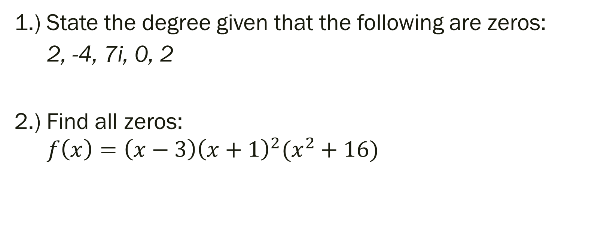
Unit 2 Quiz 2 Level 2
1.) State the degree given that the following are zeros:
2, -4, 7i, 0, 2
2.) Find all zeros:
$${f\left(x\right)=\left(x−3\right)\left(x+1\right)}^{2}(x^{2}+16)$$

Slide 6
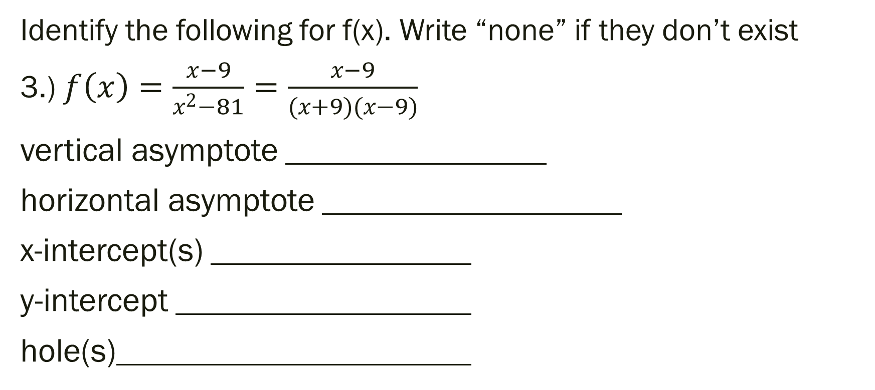
Unit 2 Quiz 2 Level 3
Identify the following for f(x). Write “none” if they don’t exist
3.) $f\left(x\right)=\frac{x−9}{x^{2}−81}=\frac{x−9}{(x+9)(x−9)}$
vertical asymptote
horizontal asymptote
x-intercept(s)
y-intercept
hole(s)

Slide 7
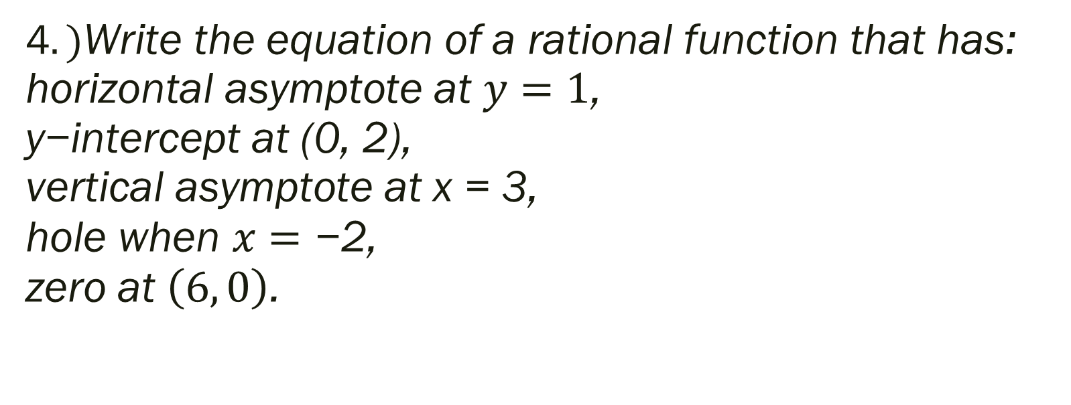
Unit 2 Quiz 2 Level 4
4$.)\text{Write} \text{the} \text{equation} \text{of} \text{a} \text{rational} \text{function} \text{that} \text{has}\text{:} \text{horizontal} \text{asymptote} \text{at} y=1\text{, } \text{y}\text{−}\text{intercept} \text{at}\text{ (0, 2), }\text{vertical} \text{asymptote} \text{at} \text{x}\text{ = 3, }\text{hole} \text{when} x=\text{−2,}$ $$\text{zero} \text{at} \left(6, 0\right)\text{.}$$

Slide 8
For next time…
Page 206 #3, 11, 22, 23, 31-40, 55-59, 61, 63, 71, 73, 74, 83, 87, 88, 91, 92, 95, 103, 104, 107, 115-122, 125, 126

